Slide 2
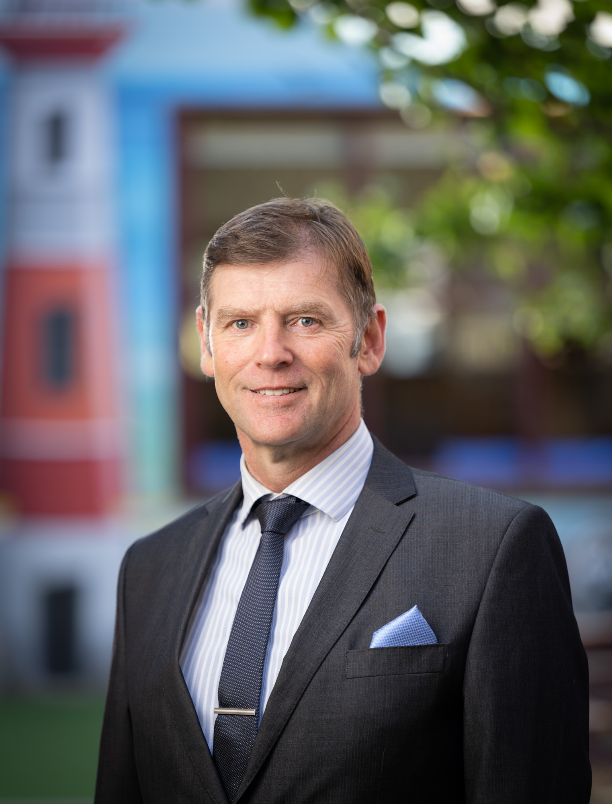
Principal address
Mark Robertson

